Slide 1
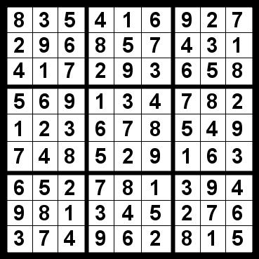
SUDOKU SOLVER Using backtrack
Name : Krishnam Upadhyay
Roll No: tycs64

Slide 2
OVERVIEW
Sudoku is one of the most popular puzzle of all time. The goal of Sudoku is to fill 9x9 grid such that each row, each column and 3x3 grid contains all of the digits between 1 to 9.
Sudoku Solver is the collection of very basic image processing techniques. A very good way to start is the OpenCV library which can be compiled on almost all the platforms.

Slide 3



PRE-REQUISITES OF THE PROJECT
PYTHON PROGRAMMING LANGUAGE
OPENCV LIBRARY, TENSORFLOW , SCI-PY AND KERAS AND IMAGE PROCESSING TECHNIQUES
DEEP LEARNING.

Slide 4
SOLUTION COMPUTATION USING GREEDY BEST-FIRST-SEARCH ALGORITHMS
The Sudoku puzzle is solved Using Greedy Best First Search Algorithms
This algorithm – an optimized version of the naïve Backtracking Algorithm - chooses the cell with the least number of possibilities to search next, (instead of picking the next cell from top to bottom, left to right.
This greedy heuristic increases the efficiency of the program substantially as it reduces the branching factor.
It can solve any Sudoku puzzle with an average time less than 2 minute(for low end devices) and 2 second for high end which is good for a Real time Application.

Slide 5
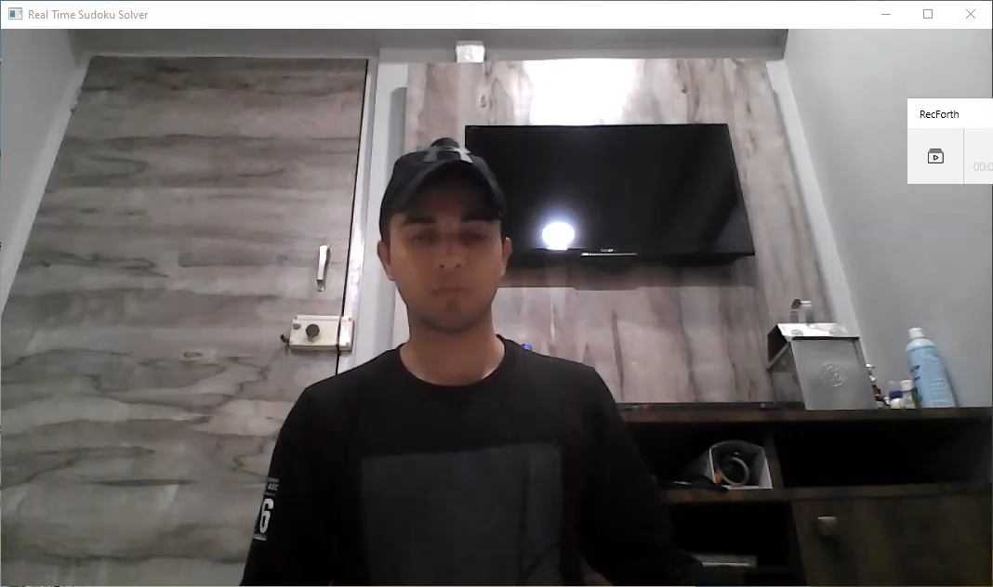
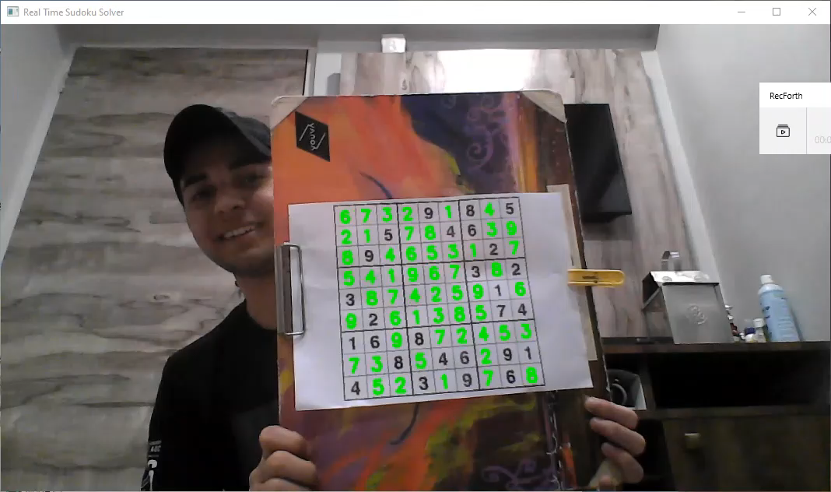
Demo of the project

